Slide 1

Presented By: Sampathi Lakshmi
Bank Customer Segmentation

Slide 2
Agenda(this should be the ppt flow)
Project Overview
Data Source
Data Preparation
Dashboard Visualizations
Applications & Recommendations
Conclusion

Slide 3
Project Overview
  This project aims to analyze customer transaction patterns, credit behavior, and risk levels using power BI.
  The goal is to identify high-risk customer, top revenue contributors, and value distribution across customer segments.
  Insights help improve customer profiling, risk management, and targeted marketing Strategies.
  Metrics such as Credit Score, Account Balance, Risk Level, and Transaction value are Analyzed.
  The dashboard provides a data-driven overview of customer performance and business risk.

Slide 4
Data Source
The dataset used is ‘bank _ transactions’, containing detailed financial records of customer activities. Techniques Used:
Key columns include:
Customer, Cust Gender, Cust Account Balance, Transaction Amount (INR), Credit Score, Customer Segment, Value Score, and Risk Level.
Data was extracted from transactional logs and cleaned for duplicates, missing values, and inconsistent entries.
Each record represents a single transaction associated with a customer.
The dataset serves as the foundation for generating KpI and visual insights in power BI.

Slide 5
Data Preparation
Created calculated columns and measures in Power BI DAX for deeper insights.
Example Calculated Fields:
CreditScore value→ Combines account balance and transaction amount.
ValueScore→ Categorizes customers value contribution.
RiskLevel→ categorizes customers into Low, Medium, or High risk based on CreditScore thresholds.
Applied data transformations: formatting dates, grouping customer by segment, and creating hierarchies.
Relationships were built between key entities to enable cross-filtering
Data model optimized for performance and dynamic filtering.

Slide 6
Dashboard Visualizations
Designed interactive visuals to explore customer and financial data.
Key Visuals:
  Cred Visuals→ Total Revenue, Average Credit Score, High-Risk Count.
  Bar/columns Chart→ Revenue by Customer Segment or Risk Level.
  Scatter plot→ Relationship between Account Balance & Risk Level.
  Pie/ Donut Chart→ Distribution of Customers by Risk Level.
  Table with Filters→ Top 10 High-Revenue, High-risk Customers.
  Slicer Filters→ filter by Credit Score, Value Score, or Risk Category.
  Dynamic visuals enable users to drill down by segment or date.

Slide 7
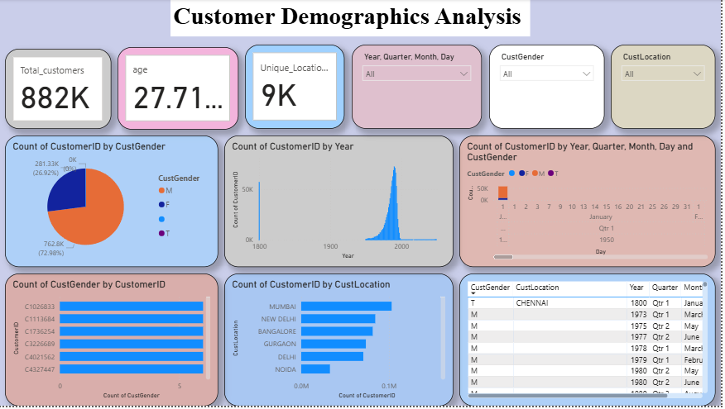

Slide 8
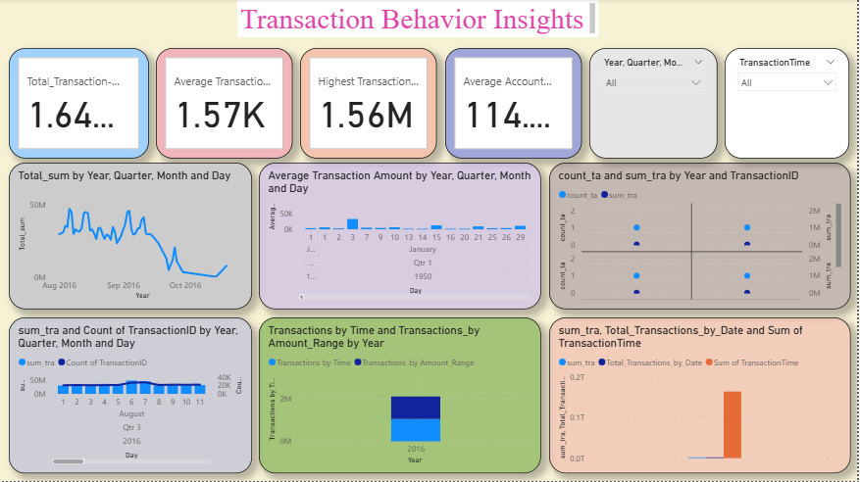

Slide 9
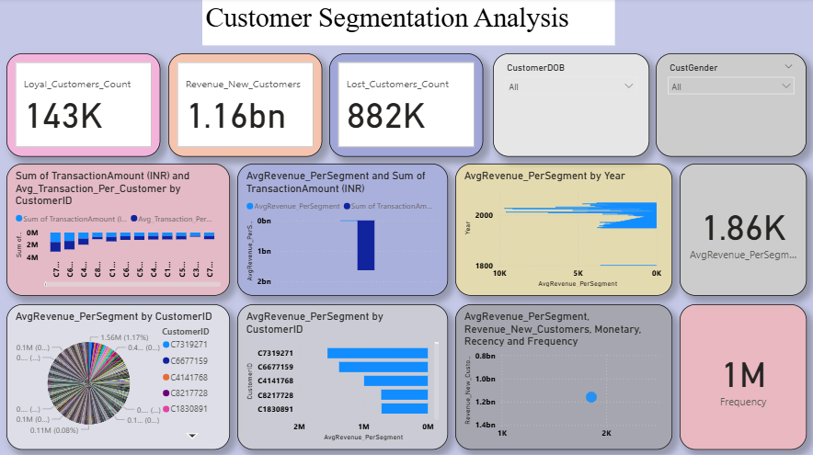

Slide 10
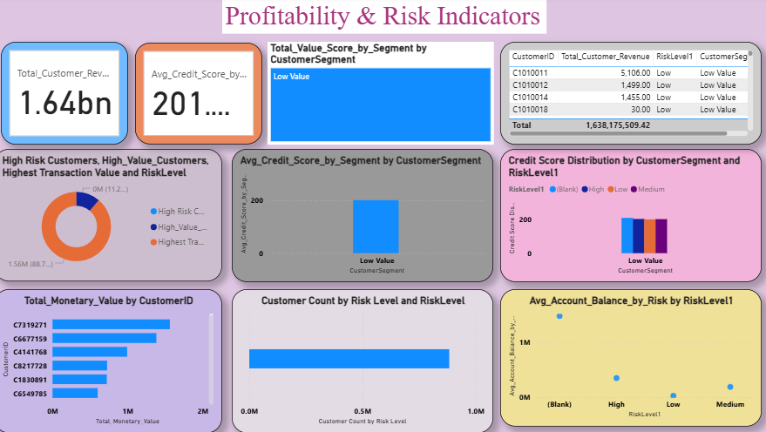

Slide 11
Applications & Recommendations
APPLICATIONS:
Identify and monitor high-risk customers to mitigate potential losses.
Segment customers for Personalized offers based on Value Score and Risk Level.
Improve Credit Assessment models by analyzing behavioral patterns.
Use visual insights for Decision-Making in risk management and marketing.
Recommendations:
Focus retention campaigns on high-value but moderate-risk customers.
Increase data integration with CRM for richer behavioral tracking.
Automate alert systems for unusually high-risk transactions.

Slide 12
Conclusion
The Power BI dashboard Successfully visualizes key business and risk insights.
Provides actionable intelligence to improve Financial Strategy and Customer Management.
Demonstrates how data analytics can help in Proactive risk control and profit Optimization.
Future enhancements can include Predictive Modeling for risk fore.

Slide 13

THANK YOU

